Slide 1
Artificial Intelligence Club
Mr. Hatcher
1271

Slide 2
Last week
Discuss what we do
What is plan for future
Get ready for the amazing year
Lets make it more interactive

Slide 3
AI Ideas?

Slide 4
Basics
Fill out start form
Pay OSP - $15

Slide 5
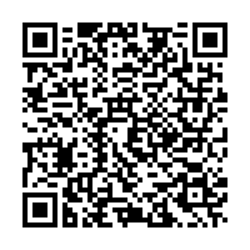
Leadership
Different roles
Programming Lead
Research lead
Social Media and Treasury Manager
https://bit.ly/2kGosuU

Slide 6
Slide Title
Product A
Product B
Feature 1
Feature 2
Feature 3
Feature 1
Feature 2
Feature 3

Slide 7


